Slide 1

SORTIFY
An Intelligent Garbage Classifier Bot
- ECO Mavericks

Slide 2

Table Of Contents
Introduction
Business Model & Revenue Streams
Customer Segments & Market Opportunity
Strategic Planning & Growth
Financial Projections & Investment Needs
Technical Overview
Innovation & Future Developments

Slide 3

Challenges in Waste Management
Inefficient Waste Segregation and Collection leads to increased pollution and ineffective waste management.
High Dependency on Manual Labor makes sorting costly, time-consuming, and unsustainable.
Limited Awareness and Adoption of Smart Waste Solutions prevent the implementation of automated waste management systems.
Poor Waste Segregation reduces the efficiency of waste-to-energy conversion, limiting recycling potential and increasing landfill waste.

Slide 4

What Makes SORTIFY Unique?
Fully Autonomous Waste Management powered by AI for efficient sorting and collection.
IoT and GPS-Enabled Real-Time Tracking allows users to monitor bot performance and waste collection progress.
Minimizes Human Dependency by automating waste segregation, reducing labor costs and inefficiency.
Adaptable for Multiple Environments, including schools, industries, public spaces, and smart cities.

Slide 5

Sortify’s Revenue & Growth Strategy
Revenue Streams:
Direct Product Sales of Sortify bots to institutions and municipalities.
Annual Maintenance Contracts for long-term servicing and upgrades.
Subscription-Based IoT Services for remote monitoring and real-time analytics.
Data Analytics Services for waste tracking insights and optimization strategies.
Cost Structure:
Hardware Costs: ₹35,000 - ₹50,000 per unit.
Software Development: ₹20,000 (in-house).
Manufacturing & Assembly: ₹15,000 - ₹30,000 per unit.
Marketing & Maintenance: ₹50,000 per year.
Prototype Costs: ₹25,000

Slide 6

Who Can Benefit from Sortify?
Primary Customers:
Educational Institutions such as schools and colleges to promote eco-friendly waste management.
Gated Communities for maintaining cleaner residential areas.
Industrial Parks and Theatres to optimize large-scale waste collection and disposal.
Event & Exhibition Centers for efficient post-event waste handling.
Secondary Customers:
Non-Governmental Organizations (NGOs) focusing on environmental sustainability.
Corporate Social Responsibility (CSR) Initiatives for industries adopting green policies.
Tourist Spot Management Authorities for maintaining cleanliness in high-traffic areas.
Cleaning Service Providers for optimizing waste collection processes.

Slide 7

Market Opportunity & Industry Overview
Global Waste Management Market is projected to reach $2.5 trillion by 2030.
Urban waste generation is increasing due to population growth and industrialization.
Governments and organizations are investing in smart waste solutions to meet sustainability goals.
Sortify aligns with global initiatives such as UN Sustainable Development Goals (SDGs) for environmental sustainability.

Slide 8

Business Scalability & Future Expansion
Short-Term Goals (1-2 Years)
Launch pilot projects in schools, universities, and gated communities.
Secure initial customers and test real-world waste sorting efficiency.
Strengthen mobile app features and IoT connectivity.
Mid-Term Goals (3-5 Years)
Scale production to municipal corporations and smart cities.
Develop modular waste bots for different environments (e.g., beaches, industrial zones).
Establish partnerships with sustainability-driven corporations.
Long-Term Vision (5+ Years)
Expand internationally with customized solutions for different waste management needs.
Integrate machine learning to predict waste trends and optimize collection routes.
Develop a network of interconnected smart waste bots.

Slide 9

Financial Projections & Investment Needs
Initial Investment Required:
₹10-15 Lakhs for R&D, production, and marketing.
Revenue Projections:
Year 1: ₹50 Lakhs (pilot phase)
Year 2: ₹2 Crore (expansion into industrial & municipal sectors)
Year 3+: ₹10 Crore+ (national & international scaling)
Funding Utilization:
50% for manufacturing & assembly
30% for software development & AI model improvements
20% for marketing & outreach
Break-even Point: Expected within 2-3 years based on subscription and product sales.

Slide 10
How We Plan to Enter the Market
Pilot Projects with Schools, Colleges & Industrial Parks to gain attraction.
Collaboration with Municipalities & Smart City Initiatives to promote large-scale adoption.
CSR Partnerships with companies focusing on sustainability & green technology.
Digital Marketing & Awareness Campaigns to educate the public about smart waste solutions.
Strategic Partnerships & Go-To-Market Strategy

Slide 11

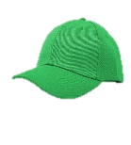


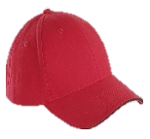
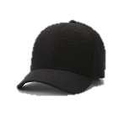
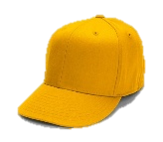
The Six Thinking Hats of Sortify
Green & Blue Hat (Creativity & Leadership) – Seshadhri
Designed robotic navigation, automation mechanisms, and sorting improvements.
Managed project planning, structured execution, and technical innovation.
White Hat (Facts & Information) - Ajay Shrikaanth
Evaluated hardware feasibility, vacuum structure and technical constraints along with Machine Learning.
Red Hat (Intuition & Instincts) - Adarsh
Developed solar power integration and voltage monitoring for sustainability.
Black Hat (Risks & Limitations) - Ashwin
Identified potential failures in AI classification, hardware limitations, and scalability challenges.
Yellow Hat (Optimism & Strengths) - Kamalesh
Focused on UI/UX improvements, Flutter mobile app integration, and enhanced user experience for monitoring the bot.

Slide 12
Autonomous Navigation & Intelligent Movement
Current Implementation:
Integrated high-torque motors, motor drivers (L298N), and Raspberry Pi 4 for precise navigation.
LiDAR (RPLIDAR A1) and ultrasonic sensors (HC-SR04) enable real-time obstacle detection, 2D mapping, and path correction.
12V to 5V step-down converter & USB converter (5V to 5V) ensure stable voltage supply for continuous operation.
The system successfully navigates autonomously, avoiding obstacles and dynamically adjusting its path.
Next Steps:
Improve AI-driven movement optimization for better decision-making in complex environments.
Enhance multi-terrain adaptability for operations in beaches, parks, and industrial sites.
Integrate collision prediction technology to prevent sudden impacts.

Slide 13

AI-Powered Smart Waste Segregation
Current Implementation:
Developed a custom CNN model to classify biodegradable & non-biodegradable waste with 85-90% accuracy.
Uses OpenCV & Raspberry Pi Camera for real-time image capture and classification.
Augmented dataset with varied lighting conditions, angles, and object types for robust classification.
Successfully detects and classifies waste in real-world testing scenarios.
Integrated YOLO Mini for faster and higher-accuracy waste detection.
Next Steps:
Expand classification categories to include E-waste, recyclables, and sanitary waste.
Implement cloud-based AI learning to continuously improve model accuracy.

Slide 14

Power Electronics & Solar System
Current Implementation:
25W solar panel with a solar boost converter increases output to 16.8V.
Power split for relay-controlled charging and motor driver, managed by Raspberry Pi Pico and NPN transistor.
Voltage sensor monitors power, and Thonny IDE controls the relay system via transistor.
BMS distributes power efficiently, with step-down regulators ensuring a stable supply.
Docking station charges the bot when the battery is low.
Next Steps:
Implement fast-charging technology and enhance solar panel tilt for better sunlight absorption.
Develop power-sharing between multiple bots and optimize BMS for better power distribution.

Slide 15
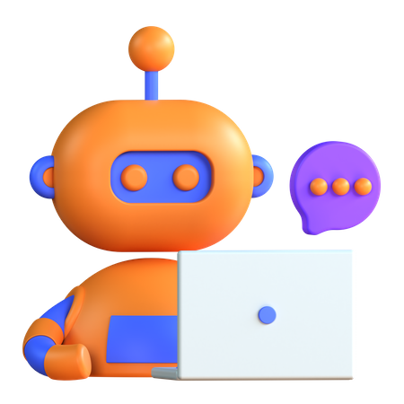
Flutter-Based Sortify App
Current Implementation:
Built using Flutter for Android-platform compatibility.
GPS tracking system provides real-time bot location updates.
Monitors real time weather to check if the weather is suitable for the bot to run.
SQLite database for offline storage, allowing user authentication without an internet connection.
Next Steps:
Implement cloud-based data storage (Firebase) for remote access & analytics.
Add customizable alerts & voice notifications for better user interaction.
Develop an interactive dashboard for detailed waste collection insights and analytics.
IoT integration delivers real-time bot status and waste collection analytics.

Slide 16

Vacuum System & Waste Sorting
Current Implementation:
High-efficiency suction motor ensures effective waste collection.
IoT-controlled vacuum activation ensures energy efficiency by running only when needed.
Successfully sorts waste based on machine learning classification.
Next Steps:
Enhance suction power to handle denser waste materials.
Develop a waste compression mechanism to increase storage capacity.
Implement odor detection sensors for organic waste monitoring.
Servo-driven sorting bins automate segregation and disposal of classified waste.

Slide 17
Meet the Founders & Core Team
Kamalesh – Mobile App & UI/UX
Expertise: Flutter Development
Ashwin – Machine Learning Engineer
Expertise: AI & Data Science
Adarsh – IoT & Software Development
Expertise: Embedded Systems, IoT
Ajay Shrikaanth – Hardware Vacuum system & ML’
Expertise: Power Electronics,
Seshadhri – Robotics & Navigation
Expertise: AI Navigation, Bot Mechanics

